Slide 1


Module-2
CSE3513 –NoSQL
Presented By: Aadil Ferooz
Babitah Mam
School of Computer Science and Engineering

Slide 2



Distributed Data Systems and Consistency Models in NoSQL
Introduction
Modern applications (social media, e-commerce, banking) store huge amounts of data.
Single servers can’t handle this scale → we use Distributed Data Systems.
NoSQL databases (MongoDB, Cassandra, Couchbase, DynamoDB, etc.) are often distributed for scalability and fault tolerance.

Slide 3
Key Features:
Data is stored on multiple machines.
Nodes communicate over a network.
Users see it as one logical database.
Example:
Facebook – Your profile data is stored in one server, photos in another, messages in another — all linked together.
3. Why NoSQL uses Distributed Systems
Scalability – Handle billions of records by adding more machines.
Fault Tolerance – If one machine fails, others still serve data.
High Availability – Users can access data anytime, from anywhere.
Low Latency – Data stored close to where it’s used.

Slide 4
4. Challenges in Distributed Systems
Data Replication – Copies of the same data exist on multiple nodes.
Network Delays – Updates take time to reach all nodes.
Conflicts – What if two users update the same record at the same time?
CAP Theorem – In a distributed system, you can only guarantee two of the following at the same time:
  Consistency (C)
  Availability (A)
  Partition Tolerance (P)

Slide 5
5. Consistency Models in NoSQL
When data is replicated, consistency refers to how up-to-date and synchronized the copies are.
5.1 Strong Consistency
All clients see the same data at the same time.
After an update, any read will return the latest value.
Example: Banking – If you transfer money, your balance should update instantly everywhere.
Drawback: Can be slower because all nodes must be updated before confirming.
5.2 Eventual Consistency
Updates are not immediately visible everywhere, but all replicas will become consistent eventually.
Example: Social media likes — You might see "99 likes" while your friend sees "100 likes" for a few seconds.
Advantage: Very fast for high-traffic systems.
Drawback: Temporary stale reads.

Slide 6
5.4 Read-Your-Writes Consistency
After you write (update) data, you always see your own update immediately.
Example: Editing your profile picture — you see the new picture instantly, even if others still see the old one.
5.5 Monotonic Read Consistency
Once you have read a value, you will never read an older value in later reads.
Example: If you saw your bank balance as ₹5000, the next check will never show ₹4900.

Slide 7
6. How NoSQL Databases Handle Consistency
MongoDB → Configurable: Strong or eventual consistency.
Cassandra → Tunable consistency (you choose how many replicas must agree).
Amazon DynamoDB → Offers eventual consistency by default, strong consistency on request.

Slide 8
Use Case | Preferred Consistency Model
Banking | Strong Consistency
Social Media Posts | Eventual Consistency
E-commerce Inventory | Tunable (depends on needs)
Messaging Apps | Causal / Read-Your-Writes

Slide 9
8. Real-World Example
WhatsApp message delivery:
  You see the message immediately → Read-your-writes.
  Your friend gets it after network delivery → Eventual consistency.
Messages maintain order in a conversation → Causal consistency

Slide 10
. Example Explanation
Imagine 3 data centers: India, USA, Europe.
You update your profile picture in India.
With strong consistency, USA and Europe update instantly before confirming.
With eventual consistency, they update later but allow instant response to you.

Slide 11
10. Key Takeaways
Distributed systems spread data across many nodes for scalability and reliability.
Consistency models define how up-to-date the data is across replicas.
NoSQL databases often trade off strong consistency for better performance.
Choosing the right consistency model depends on the application’s needs.

Slide 12
Single Server in Distributed Data Systems and Consistency Models (NoSQL Context)
Introduction
In NoSQL databases, data can be stored in different ways depending on the distribution model.
The simplest and most basic model is the Single Server Model — where all data lives on one physical server and all operations happen there.
Think of it like:
One big library in your city → everyone comes to the same place to read or borrow books.

Slide 13
. Definition
Single Server Model:
A system where all data storage, processing, and management occur on a single machine (one database instance, one host).
Clients connect to only one server for all reads and writes.
It’s centralized, not distributed, but it is the foundation for understanding more complex distributed systems.

Slide 14
Feature of single server | Description
Centralized data | All data is stored in one location (one machine).
Single point of access | All users connect to one endpoint for operations.
Strong consistency | Changes are immediately visible to all future reads.
Simpler architecture | No replication or sharding logic required.
Limited scalability | Performance limited by the hardware capacity of one server.

Slide 15
Architecture Overview
[Client 1] \
[Client 2] > ----> [ Single Server: Data + Query Processing ]
[Client 3] /
All clients send requests to the same server.
The server stores data, processes queries, and sends back results.

Slide 16
. Advantages
Simplicity – Easy to set up and manage.
Strong Consistency by default – No replication lag.
Lower initial cost – Only one server to purchase.
Faster for small datasets – No network latency between nodes.
Easy debugging and monitoring – Single point for logging and analysis
Disadvantages
Single Point of Failure (SPOF) – If the server fails, the entire system goes down.
Scalability limits – Cannot handle huge datasets or millions of users.
Performance bottleneck – All reads/writes go to one place.
No fault tolerance – No backup nodes in real-time.

Slide 17
. Consistency in the Single Server Model
In NoSQL terms:
Consistency Model: Strong Consistency — Every read gets the most recent write.
Why? No replication or network delays between multiple servers.
Example:
  In a MongoDB single-server setup, if you update a document at 10:00:00, all reads after that return the updated value instantly.

Slide 18
Single Server in NoSQL Context
Even though NoSQL databases are designed for distributed setups, most can run in single-server mode:
  MongoDB – run with one mongod instance.
  Cassandra – run with one node (good for development/testing).
  Redis – store all key-value pairs in one server.
Often used for:
  Development
  Small-scale applications

Slide 19
Scenario( when to use) | Why it fits
Small websites | Low traffic, minimal storage needs
Prototyping apps | Easier setup during early development
Internal tools | Limited users, strong consistency required
Education/training | Good for learning database basics

Slide 20
10. Example Use Case
Example: A small online bakery database.
Server stores:
  Menu items
  Orders
  Customer details
Flow:
  Customer places order → order stored in the database.
  The baker checks the same database → sees the order instantly.
Benefit: No complex sync issues.
Risk: If server crashes during peak orders → service unavailable

Slide 21
Applications
Small Business Inventory Systems – Track stock from one location.
School Databases – Student records stored centrally.
Local Library Systems – Catalog stored in one computer.
Personal Finance Tracker – Running on one local database.

Slide 22
. Summary Table
Aspect | Single Server
Complexity | Low
Consistency | Strong
Scalability | Limited
Fault Tolerance | None
Best for | Small-scale apps, prototyping

Slide 23
Sharding
Sharding in Distributed Data Systems and Consistency Models (NoSQL Context)
1. Introduction
In large-scale NoSQL systems, one server often can’t handle all the data and traffic.
Sharding is a technique where data is split into smaller pieces (shards) and stored on multiple servers (nodes).
Think of it like:
Instead of keeping all books in one huge library, you distribute them into many smaller libraries — each responsible for a subset of books.

Slide 24
2. Definition
Sharding = Horizontal Partitioning of data.
Each shard contains a subset of the total data.
Each shard is stored on a different server.
Together, all shards make up the full dataset.
Horizontal partitioning means splitting rows/documents, not columns/fields.

Slide 25
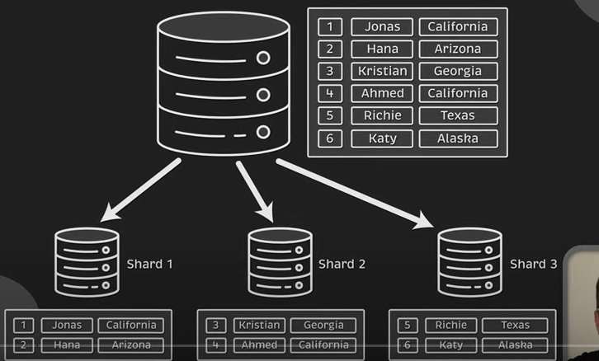

2 Diagram(sharding)

Slide 26
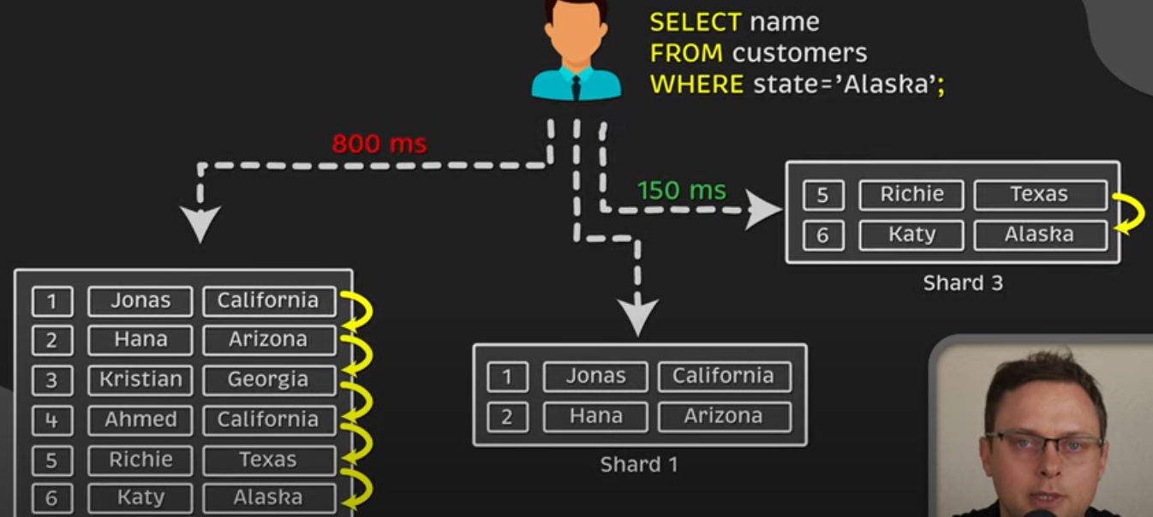
2. Diagram(sharding) Cont…

Slide 27
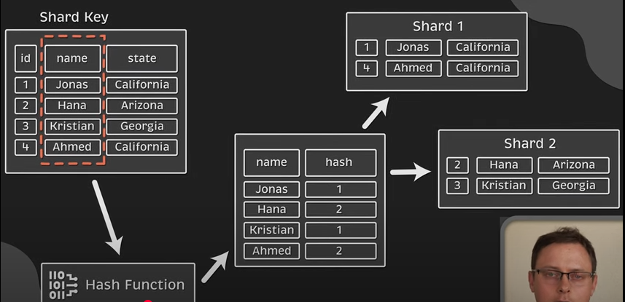

2. Diagram(sharding) Cont…

Slide 28
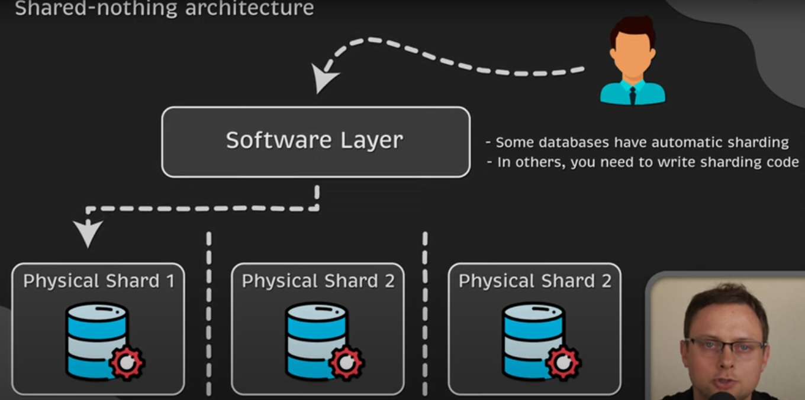

2. Architecture

Slide 29
3. Purpose of Sharding
Scale out: Add more servers to handle more data/traffic.
Avoid bottlenecks: No single server does all the work.
Improve performance: Queries hit only the shard that has the data.
Handle big data: Store datasets larger than a single machine’s capacity

Slide 30
4. Key Concepts in Sharding
Term | Meaning
Shard | A subset of the data (like one piece of the puzzle).
Shard Key | The field used to decide which shard stores a particular record.
Shard Map / Routing Table | Keeps track of which shard stores which data.
Shard Node | The physical/virtual server hosting a shard.

Slide 31
5. How Sharding Works
Step-by-step:
Choose a shard key (e.g., customer_id).
Apply a sharding strategy:
  Range-based (data split by value ranges)
  Hash-based (data split by hash value)
  Geographic/Custom (data split by custom rules)
Data is stored in the shard corresponding to the shard key’s value.
A router or query coordinator directs queries to the correct shard.

Slide 32
0
6. Sharding Strategies
6.1 Range-based Sharding
Data divided into continuous ranges of values.
Example:
  Shard 1: IDs 1–1000 OR A-G
  Shard 2: IDs 1001–2000 OR G-S
Pros: Efficient range queries.
Cons: Risk of “hot spots” if one range is accessed too much.

Slide 33
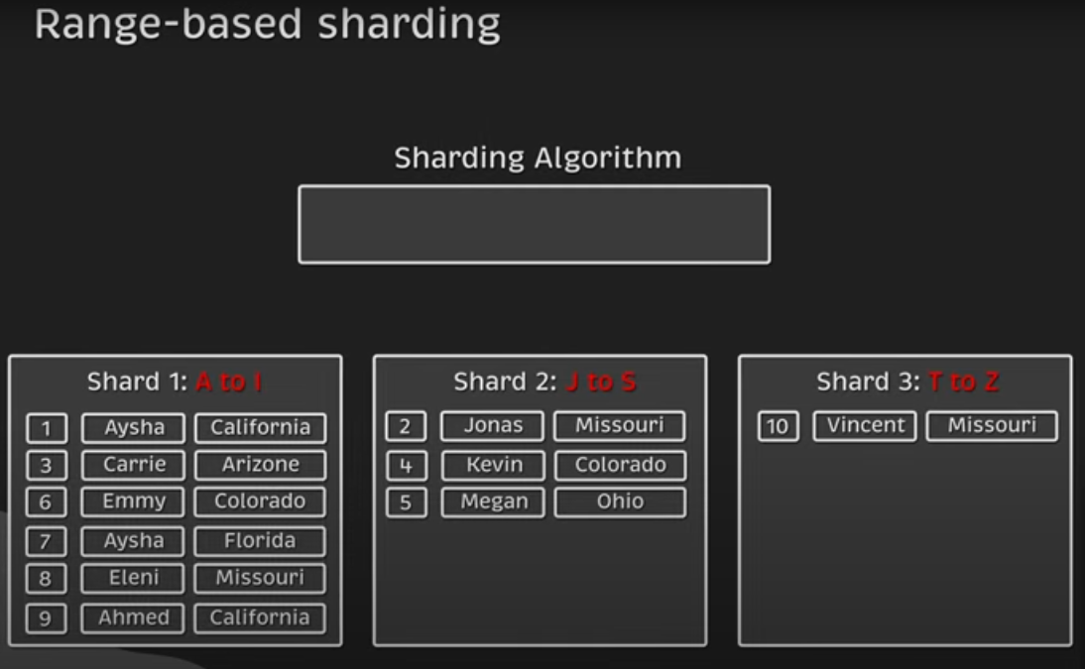
6. Sharding Strategies
6.1 Range-based Sharding

Slide 34
6.2 Hash-based Sharding
Apply a hash function to shard key → assign to shard.
Example:
  hash(customer_id) % 3 → gives shard number.
Pros: Evenly distributes data.
Cons: Range queries are harder.

Slide 35
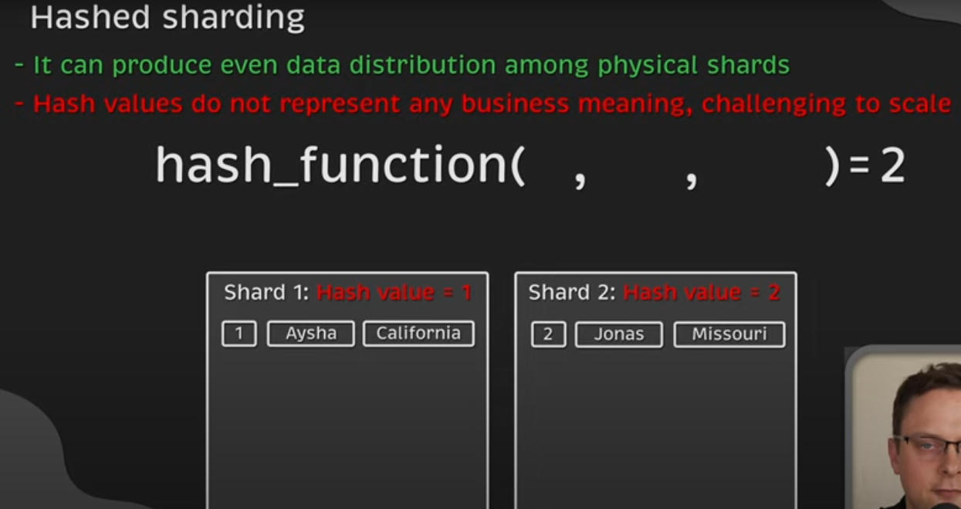
6.2 Hash-based Sharding

Slide 36
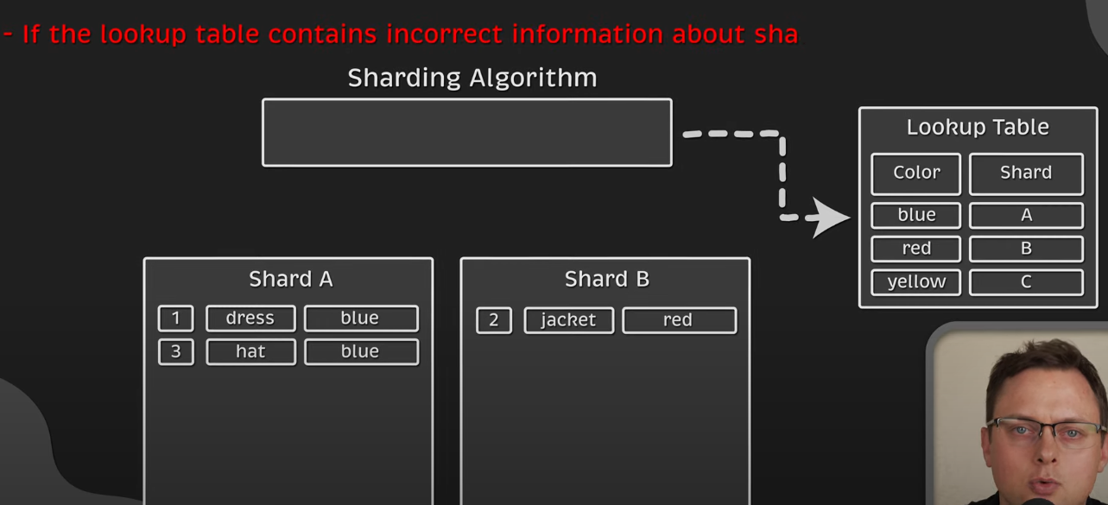
6.3 DIRECTORY-based Sharding

Slide 37
6.3 Geo-based or Custom Sharding
Partition based on location or custom business logic.
Example:
  Shard 1: Asia customers
  Shard 2: Europe customers
  Shard 3: America customers
Pros: Localized performance optimization.
Cons: Uneven distribution possible.

Slide 38
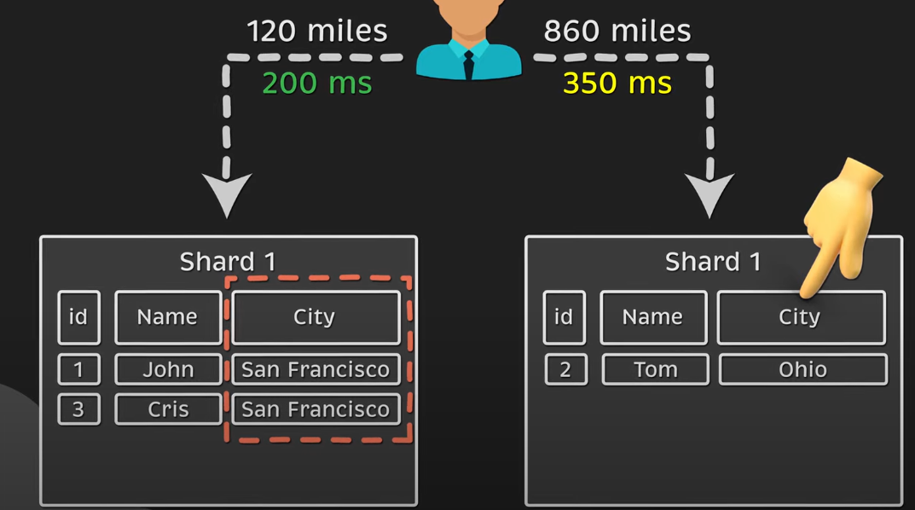
0
6.3 Geo-based or Custom Sharding

Slide 39
7. Advantages of Sharding
Scalability – Add more shards as data grows.
Performance – Queries target only relevant shards.
Fault isolation – Failure of one shard doesn’t stop others.
Cost-effective – Use many smaller commodity servers instead of one huge machine.

Slide 40
8. Disadvantages of Sharding
Complexity – Harder to design and maintain.
Rebalancing challenges – Moving data when adding/removing shards.
Cross-shard queries are expensive – Need to query multiple shards.
Potential for uneven load – Poor shard key choice can create hot spots.

Slide 41
9. Sharding and Consistency Models
Consistency depends on replication inside each shard.
In NoSQL:
  Each shard may be replicated for fault tolerance.
  Sharding + replication is common: Sharded Cluster with Replica Sets (MongoDB).
Consistency trade-offs:
  Writes to one shard do not affect others directly.
  Distributed transactions across shards are harder.

Slide 42
10. Real-world NoSQL Sharding Examples
MongoDB – Shards collections using a chosen shard key.
Cassandra – Uses consistent hashing for automatic sharding.
HBase – Uses region servers for sharding.
Elasticsearch – Index split into shards for distributed search.

Slide 43
11. Example Scenario
Example: An e-commerce platform with millions of users.
Shard key: user_id
Strategy: Hash-based sharding
Shards:
  Shard 1: Users whose hash(user_id) % 3 = 0
  Shard 2: Users whose hash(user_id) % 3 = 1
  Shard 3: Users whose hash(user_id) % 3 = 2
Result:
  All three shards handle equal load.
  Queries for one user hit only one shard.

Slide 44
12. Applications of Sharding
Social Media Platforms – Distribute user profiles across multiple servers.
Online Gaming – Store game states for millions of players across shards.
IoT Data Storage – Store sensor readings in different shards by device ID.
E-commerce – Orders distributed across shards by region or customer ID.
Search Engines – Split index into shards for faster search.

Slide 45
13. Diagram (easy to draw for class)
+----------------+
Clients -->| Query Router |
+-------+--------+
|
-------------------------
| | |
+----+----+ +----+----+ +----+----+
| Shard 1 | | Shard 2 | | Shard 3 |
+---------+ +---------+ +---------+
ID 1–1000 ID 1001–2000 ID 2001–3000

Slide 46
0
14. Summary Table
Aspect | Sharding
Type | Horizontal partitioning
Goal | Scale out, improve performance
Key Element | Shard key
Consistency | Within shard: strong; Across shards: depends
Best for | Very large datasets, high traffic

Slide 47
Master -slave
Master-Slave Replication in Distributed Data Systems (NoSQL Context)
1. Introduction
In distributed data systems, especially in NoSQL databases, replication means storing multiple copies of the same data on different servers.
Master-Slave Replication is one of the oldest and most widely used replication models.

Slide 48
2. Definition
Master-Slave Replication = A replication model where:
Master node: The primary server that handles all write operations (and often reads).
Slave nodes: One or more secondary servers that receive replicated data from the master (usually read-only).
Analogy:
Think of a teacher (master) who writes the original notes, and tution students (slaves) who copy them exactly into their notebooks. Students can read from their notes, but they can’t write changes back into the teacher’s notebook.

Slide 49
Write operation means making changes to the database.
Examples: inserting a new record, updating an existing record, or deleting data.
In this model, only the Master node performs write operations.
Read operation means retrieving or accessing data from the database without changing it.
Examples: fetching a student’s details, generating a report, or looking up product prices.
In this model, both the Master and the Slave nodes can handle read operations, but usually, the Slaves are mainly used for reads to reduce the load on the Master.

Slide 50
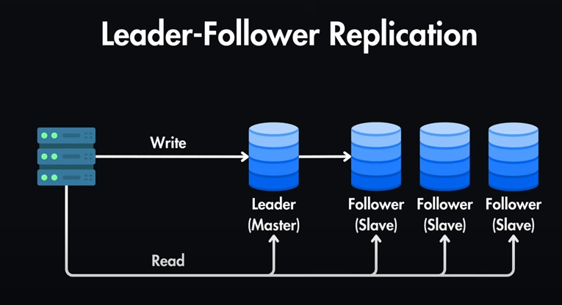

Slide 51
3. How It Works
Step-by-step process:
Write operations go to the Master.
Master processes the change and logs it.
The change log is sent to all Slave nodes.
Slave nodes apply the changes to their copy of the data.
Read operations can be directed to:
  Master (for the latest data).
  Slaves (to distribute load).

Slide 52
4. Key Components
Component | Role
Master Node | Accepts writes, ensures data correctness, sends updates to slaves.
Slave Node | Holds a replicated copy, accepts reads, syncs with master.
Replication Log | Tracks changes on the master to send to slaves.
Replication Channel | Network link for sending changes to slaves.

Slide 53
5. Replication Types in Master-Slave
5.1 Synchronous Replication
Master waits for acknowledgment from all slaves before confirming the write.
Pros: Strong consistency.
Cons: Slower writes, higher latency.
5.2 Asynchronous Replication
Master confirms write immediately, sends updates to slaves later.
Pros: Fast writes.
Cons: Slaves may lag behind (eventual consistency).

Slide 54
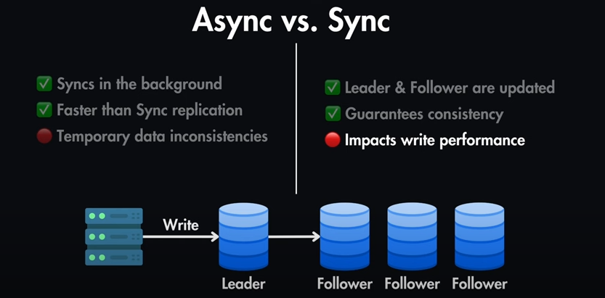
5. Replication Types in Master-Slave

Slide 55
6. Master-Slave in Consistency Models
Strong Consistency: Achievable with synchronous replication.
Eventual Consistency: Common in asynchronous replication (slaves catch up later).
Read-After-Write Consistency: Guaranteed only if reading from master.

Slide 56
7. Advantages
Read Scalability – Multiple slaves can serve reads.
High Availability – If master fails, a slave can be promoted to master.
Data Backup – Slaves act as live backups.
Load Balancing – Distributes read load.
8. Disadvantages
Write Bottleneck – Only one master handles writes.
Replication Lag – Slaves may have outdated data (in async mode).
Failover Complexity – Promoting a slave to master can be tricky.
Single Point of Failure – If master fails before replication, data loss can occur.

Slide 57
9. Example in NoSQL Databases
MongoDB – Replica sets can be configured in a primary-secondary (master-slave) pattern.
Redis – Supports master-slave replication for read scaling.
Cassandra – Although more peer-to-peer, it can simulate master-slave roles in certain configurations.
10. Example Scenario
Scenario: A social media app with millions of users.
Master handles all posts, likes, and comments writes.
Slaves handle profile searches, feed loading, and viewing comments (reads).
If traffic spikes, more slave nodes can be added to handle reads without affecting the master.

Slide 58
11. Real-world Applications
E-commerce websites – Product updates handled by master, product searches handled by slaves.
Social networks – Posting a new update (master), reading feeds (slaves).
Online gaming – Master stores player state updates, slaves handle leaderboard reads.
Content delivery platforms – Master stores uploaded files metadata, slaves serve read requests.

Slide 59
12. Simple Diagram
Writes
Client ------------------> Master
Reads \
\-------> Slave 1
\------> Slave 2
\-----> Slave 3

Slide 60
13. Summary Table
Feature | Master | Slave
Writes | Yes | No
Reads | Yes (latest) | Yes (may lag)
Data source | Original | Replicated
Failure role | Promotes slave | Can be promoted

Slide 61
Peer to peer
Peer-to-Peer Replication in Distributed Data Systems (NoSQL Context)
1. Introduction
In distributed systems, replication ensures high availability, fault tolerance, and scalability.
Unlike Master-Slave Replication, where only one node accepts writes, Peer-to-Peer (P2P) Replication allows every node to:
Accept read requests
Accept write requests
Synchronize changes with others
📌 Analogy:
Think of a WhatsApp group where everyone can send and receive messages — there’s no “main” sender. Every member’s phone is like a peer

Slide 62
2. Definition
Peer-to-Peer Replication = A replication strategy where all participating nodes are equal (peers), and any node can update data. Updates are propagated to all other peers.
3. How It Works
Step-by-step:
Any peer can accept a read or write request.
When a write occurs:
  The node updates its local data.
  It sends the update to all other peers.
Other peers apply the change to their copy of the data.
The system uses conflict resolution if two nodes update the same data at the same time.

Slide 63
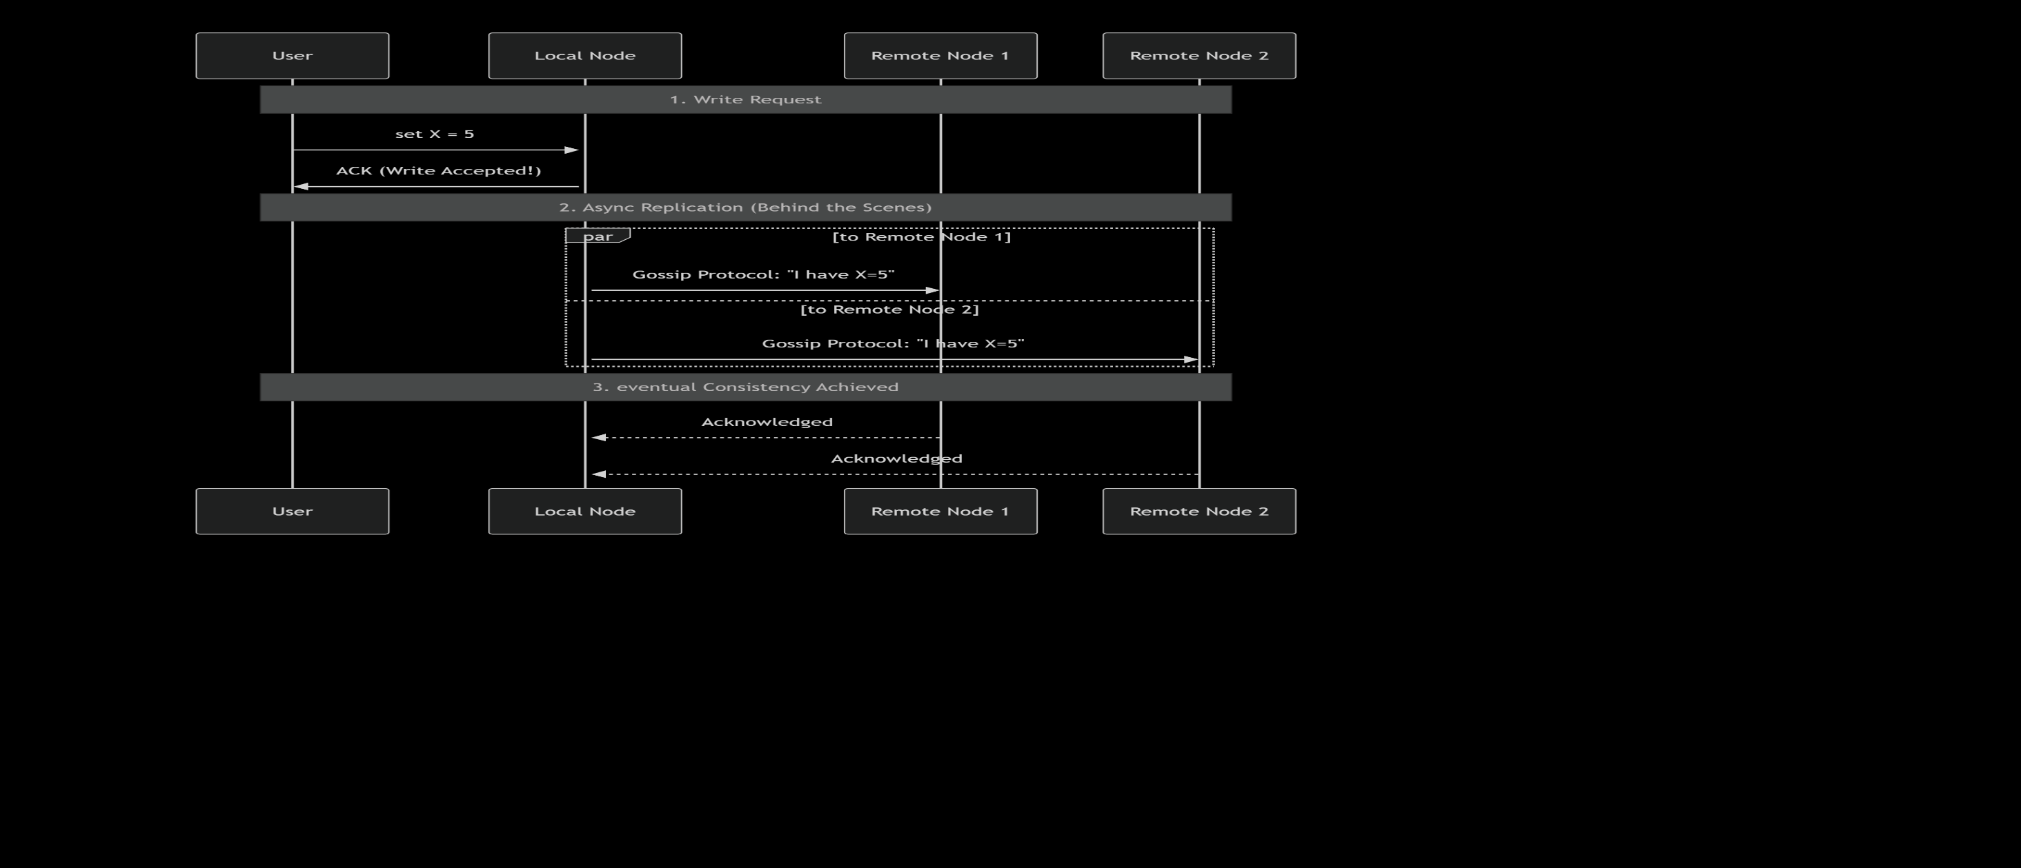
2. Diagram for peer to peer

Slide 64
2. Diagram Explanation
1.The user writes data to their closest node. The node accepts the write and immediately acknowledges it to the user, providing low latency.
2.After acknowledging, the node then takes responsibility for asynchronously propagating that change to its peers. This is often done using a gossip protocol (like how rumors spread), where nodes periodically exchange their latest data with a few random peers.
3.Eventually, all nodes receive the update and converge to the same state. This delay is the "eventual" part of eventual consistency.

Slide 65
4. Key Components
Component | Role
Peer Node | Holds full or partial data, can process reads/writes.
Replication Protocol | Rules for sharing updates among peers.
Conflict Resolver | Handles cases where two peers change the same data.
Network Mesh | The communication structure connecting peers.

Slide 66
5. Conflict Handling
In P2P replication, conflicts can occur when two peers update the same data before syncing.
Common conflict resolution strategies:
Last Write Wins (LWW) – The most recent timestamp wins.
Application-defined rules – Example: In e-commerce, keep the highest inventory count.
Merge changes – Combine updates if possible.
📌 Example:
Two peers update a user’s profile picture at the same time.
In LWW: The update with the later timestamp is kept.
In merge: The system might prompt the user to choose.

Slide 67
6. Peer-to-Peer in Consistency Models
Eventual Consistency: Most common; updates propagate gradually until all peers have the same data.
Strong Consistency: Possible but complex — requires coordination and locking.
Causal Consistency: Updates that are related are seen in the correct order across peers.

Slide 68
7. Advantages
No single point of failure – All nodes can handle writes.
High availability – Even if several nodes go down, others can continue.
Write scalability – Multiple writes can happen at the same time in different locations.
Geographical distribution – Ideal for apps with global users.

Slide 69
8. Disadvantages
Conflict resolution complexity – More chances of update conflicts.
Higher network traffic – Each write must be shared with all peers.
Data convergence delay – Time needed for all peers to sync.
9. Examples in NoSQL Databases
CouchDB – Uses multi-master (peer-to-peer) replication.
Cassandra – All nodes are peers; data is partitioned and replicated.
Riak – Offers decentralized replication.

Slide 70
10. Example Scenario
Scenario: A ride-sharing app like Uber.
Multiple servers across the world (peers).
A driver in India updates their status to "Available".
That change is sent to all peers, so riders everywhere see the updated availability.
If two peers update at once (e.g., driver changes to "Busy" and another server sets "Available"), conflict resolution rules decide the final status.

Slide 71
11. Real-world Applications
Global social networks – Users update profiles from anywhere; data syncs globally.
Collaborative tools – Google Docs-like real-time editing from multiple users.
Content delivery – Media files uploaded in one region available in all regions.
Offline-first apps – Users work offline, and updates sync when connected.

Slide 72
12. Simple Diagram
Peer A <-----> Peer B
^ \ / ^
| \ / |
v \ / v
Peer C
All peers are equal and can talk to each other directly.

Slide 73
13. Comparison: Master-Slave vs Peer-to-Peer
Feature | Master-Slave | Peer-to-Peer
Write Nodes | Only master | All peers
Read Nodes | Master + Slaves | All peers
Single Point of Failure | Yes (master) | No
Conflict Handling | Rare | Common, must be resolved
Consistency | Strong (if sync) | Usually eventual

Slide 74
Key Takeaway
Peer-to-Peer replication is ideal for high availability and global systems where any node can process updates. However, it requires smart conflict resolution and careful design to maintain data consistency

Slide 75
Combining Sharding and Replication Consistency
1. Introduction
Modern applications generate huge amounts of data every second (e.g., Facebook posts, Amazon orders, IoT sensors).
To manage this at scale, NoSQL databases use two main techniques:
Sharding → Distributes data across many machines.
Replication → Makes multiple copies of data for fault tolerance.
👉 But when both are combined, we must address consistency → how updates are kept in sync across shards and replicas.

Slide 76
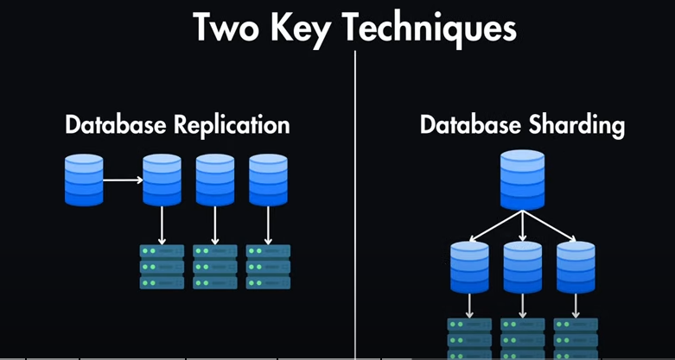
Combining Sharding and Replication Consistency

Slide 77
2. Sharding (Horizontal Partitioning)
Definition:
Splitting large datasets into smaller chunks (shards) and storing them on different machines.
How it works:
Each shard holds a subset of data.
A shard key (like user_id) decides which shard stores the data.
Example:
If we have 100 million users:
Shard 1 → Users 1–10M
Shard 2 → Users 10M–20M
…
Shard 10 → Users 90M–100M
Benefits:
Scalability (add more machines).
Performance (queries only touch relevant shard).

Slide 78

2. Sharding (Horizontal Partitioning)

Slide 79
3. Replication
Definition:
Creating multiple copies of the same data across different servers.
How it works:
One server acts as Primary → handles writes.
Other servers are Replicas → copy data from primary.
If primary fails → one replica becomes new primary.
Example:
In MongoDB:
Primary node: Latest updates.
Secondary replicas: Used for read queries.
Benefits:
Fault tolerance (no data loss).
High availability (system still works if one node fails).
Read scaling (read queries spread across replicas).

Slide 80
4. Why Combine Sharding + Replication?
Sharding alone → distributes data but not fault tolerant.
Replication alone → fault tolerant but not scalable with huge datasets.
Together:
  Sharding → handles big data scale.
  Replication → ensures availability and reliability.
👉 Almost all large-scale NoSQL databases combine both.

Slide 81
5. Combined Architecture
Each shard is a replica set (not just one machine).
Queries are routed to the correct shard and then served from a replica.
Example Flow:
User writes a new post.
Request goes to the correct shard (based on user ID).
That shard has 1 primary + multiple replicas.
Update is written to primary → then copied to replicas.

Slide 82
6. Consistency in Sharded + Replicated Systems
When sharding and replication are combined, consistency ensures that all users see correct and up-to-date data.
6.1 Types of Consistency
Strong Consistency
  All nodes see the same data immediately.
  Example: Banking transactions.
  Drawback: Higher latency.
Eventual Consistency
  Updates propagate gradually → users may see slightly stale data.
  Example: Social media likes count.
  Drawback: Temporary inconsistency.

Slide 83
3 Causal Consistency
Related operations are seen in order.
Example: Alice posts → Bob’s reply must come after Alice’s post.
4 Tunable Consistency (in Cassandra, DynamoDB)
Developers choose level per operation (e.g., ONE, QUORUM, ALL).
Balance between speed and accuracy.

Slide 84
7. Challenges in Combining Both
Cross-shard transactions: Updating multiple shards while keeping replicas in sync is complex.
Trade-off (CAP theorem): Can’t have all 3 at once → Consistency, Availability, Partition tolerance.
Network Latency: Strong consistency requires more coordination.
Load balancing: Distributing queries evenly among shards and replicas.

Slide 85
8. How Popular Databases Handle It
MongoDB
Uses sharded clusters.
Each shard = a replica set.
Consistency: Strong by default (primary), but can read from replicas for eventual consistency.
Cassandra
Uses consistent hashing for sharding.
Each shard is replicated across multiple nodes.
Offers tunable consistency (e.g., QUORUM, ONE, ALL).
Amazon DynamoDB
Automatic sharding + replication.
Default: Eventual consistency (faster).
Optional: Strong consistency (slower).

Slide 86
9. Real-Life Use Cases
E-commerce (Amazon, Flipkart)
  Sharding: Distributes millions of product listings.
  Replication: Ensures carts/orders are never lost.
  Consistency: Strong for payments, eventual for recommendations.
Social Media (Facebook, Twitter, Instagram)
  Sharding: Posts/comments spread across many servers.
  Replication: Global availability.
  Consistency: Eventual is acceptable (likes may update with delay).
Banking Systems
  Sharding: Different branches’ data stored separately.
  Replication: Ensures no transaction is lost.
  Consistency: Must be strong (balances cannot mismatch).
IoT Data Platforms
  Sharding: Billions of sensor readings stored across nodes.
  Replication: Prevents data loss during node failure.
  Consistency: Often eventual (slight delay in updates is okay).

Slide 87
10. Advantages of Combining Both
✅ Scalable → Can handle huge datasets.
✅ Reliable → Data is not lost if servers fail.
✅ Flexible consistency → Choose strong/eventual/tunable.
✅ Better performance → Reads/writes distributed across shards and replicas
11. Example Scenario (Simple)
Imagine a global shopping website:
Sharding:
  Asia customers → Shard A
  Europe customers → Shard B
  America customers → Shard C
Replication:
  Each shard has 1 primary + 2 replicas.
Consistency:
  Payments = Strong consistency.
  Product catalog = Eventual consistency.

Slide 88
12. Summary
Sharding = Divide data for scalability.
Replication = Copy data for availability.
Consistency = Controls how updates are visible.
Combining them = Foundation of modern distributed NoSQL systems like MongoDB, Cassandra, DynamoDB.
Applications = E-commerce, social media, finance, IoT.
👉 This combination allows systems to be fast, fault-tolerant, scalable, and reliable.

Slide 89
Update Consistency in Distributed Systems / NoSQL Databases
1. Introduction
In distributed databases (like Cassandra, MongoDB, DynamoDB), data is often stored across multiple servers/nodes for scalability and fault tolerance.
When data is updated, the challenge is:
  How do we ensure all replicas and shards reflect the correct, latest value?
This problem is known as Update Consistency.
👉 Update Consistency defines the rules and guarantees about how updates to data are made visible across different nodes.

Slide 90
2. What is Update Consistency?
Definition:
Update consistency is the property that ensures all replicas of data converge to the same, correct value after an update operation.
In other words, after applying updates, no matter the order or replica, all nodes should agree on the final state of the data.
3. Why is Update Consistency Important?
Without it:
  Different replicas may show different values.
  Applications may behave unpredictably.
  Users may see stale or conflicting data.
👉 Example:
Alice transfers ₹1000 from Account A to Account B.
If replicas are inconsistent:
  One replica may show the old balance.
  Another replica may show the new balance.
  This can cause double spending or incorrect balances.

Slide 91
4. Key Concepts in Update Consistency
4.1 Replicated Data
Updates must propagate across all replicas.
Propagation can be synchronous (immediate) or asynchronous (delayed).
4.2 Ordering of Updates
Updates may arrive at replicas in different orders.
System must ensure the final result is consistent.
4.3 Update Conflicts
If multiple users update the same data at the same time, conflicts arise.
Example:
  User A updates product stock to 90.
  User B updates product stock to 85.
  Which value should persist?

Slide 92
5. Consistency Models Related to Updates
5.1 Strong Consistency
After an update, all clients see the latest value immediately.
Guarantees correctness but increases latency.
Example:
In banking, once you transfer money, the new balance should be visible everywhere instantly.
5.2 Eventual Consistency
Updates are applied gradually → replicas may temporarily show different values.
Eventually, all replicas converge to the latest state.
Example:
In social media, when you like a post, the like count may take a few seconds to sync globally.

Slide 93
5.3 Causal Consistency
Updates that are causally related must be seen in order.
Example:
  Alice posts a photo.
  Bob comments → must appear after Alice’s post, not before.
5.4 Read-Your-Write Consistency
After a client updates data, it should always see its own update, even if other replicas are not yet updated.
Example:
If you update your profile picture, you should immediately see the new picture (even if others see the old one temporarily).
5.5 Monotonic Write Consistency
Ensures that writes by the same client are applied in order across replicas.
Prevents an older update from overwriting a newer one.
Example:
If you change your password twice, the system should not roll back to the first password.

Slide 94
6. Mechanisms to Ensure Update Consistency
Quorum-based Writes (as in Cassandra, DynamoDB)
  Updates are written to a majority of replicas before being considered successful.
  Reduces chances of inconsistency.
Conflict Resolution
  Last-Write-Wins (LWW): The update with the latest timestamp wins.
  Application-Level Logic: Developers define custom conflict resolution rules.
Version Vectors / Timestamps
  Each update is tagged with a version/timestamp to track order.
Consensus Protocols (e.g., Paxos, Raft)
  Used in strong consistency systems to ensure replicas agree on the same update order.

Slide 95
7. Challenges in Update Consistency
Network Latency: Updates may reach replicas at different times.
Concurrent Updates: Multiple users updating same data simultaneously.
Partition Tolerance (CAP Theorem): During network failures, some replicas may lag.
Performance Trade-offs: Strong consistency slows down performance; eventual consistency is faster but less strict.

Slide 96
8. Real-World Examples
1. Banking Systems (Strong Consistency)
Money transfers must always reflect correct balance across all replicas.
Inconsistent updates can cause serious financial errors.
2. E-commerce (Mixed Consistency)
Product inventory: Strong consistency needed (to avoid overselling).
Product recommendations: Eventual consistency acceptable.
3. Social Media (Eventual Consistency)
Likes, shares, comments can be slightly delayed without harm.
Profile updates may require read-your-write consistency for user satisfaction.
4. IoT Platforms (Eventual Consistency)
Millions of sensor readings arrive per second.
Eventual consistency ensures all data converges, but slight delay is acceptable

Slide 97
9. Applications of Update Consistency
Financial applications → Banking, stock trading.
Healthcare systems → Patient records must remain accurate.
E-commerce → Inventory, cart management.
Social networking → Posts, likes, comments sync globally.
Cloud services → File storage systems (Dropbox, Google Drive).

Slide 98
0. Summary
Update consistency ensures all replicas converge to the correct value after updates.
Different models (Strong, Eventual, Causal, Read-Your-Write, Monotonic Writes) offer trade-offs between performance and correctness.
Mechanisms like quorum writes, conflict resolution, timestamps, consensus algorithms help maintain consistency.
Real-world systems apply different levels of consistency depending on application needs (critical vs non-critical updates).
👉 In short, update consistency is the backbone of trust and reliability in distributed NoSQL databases.

